Slide 1


CR²
SINAPSI
Centro Ricreativo e Riabilitativo​
​
Sustainable Innovative
Neural Architecture Poli
Synaesthetic Interaction​
​

Slide 2
Summary
Family description
Summer camp
CR² Sinapsi Project
Mission and Sustainability of the project
CR² SINAPSI​ OCCHI AZZURRI ONLUS

Slide 3
Orlando and his family
Orlando was born with a genetic deletion, a lack in his DNA that conditions his general development.
Today he is 9 years old and significantly behind his age group in terms of speech, alimentation and in his primary needs. He is making progress but he is still far from achieving a minimal level of autonomy.
His syndrome has no diagnosis and this rarity makes getting support even harder for Orlando and his family. Much analysis has already been conducted but the best strategy to promote his development still remains a mystery.
Orlando is growing up in a family where both his parents and his older brother have always been close to him. We are trying to make his life better by seeking developments in medicine, education and rehabilitation. Our difficulties are due to the lack of resources and lack of answers in our current society.
CR² SINAPSI​ OCCHI AZZURRI ONLUS
3

Slide 4
From birth to today
Since Orlando was born, he has been subjected to a host of different types of analyses: genetic, metabolic, endocrinologic.
Unfortunately, we have not received any clear answers.
We have sustained high costs and we have invested a lot emotionally, in the hope of finding effective solutions and ensuring him a bright future. For now, we would like to focus on ways of making Orlando’s life easier by reducing the level of request in his regard and increasing his performance to the highest possible levels.
Our priority is to give to Orlando and children like him a future worthy of being lived; we would also like to lighten the burden on their families. We need to raise awareness of this condition because the number of people affected is elevated and continues to increase. Disability is a social illness and the cure of this discomfort must be shared.
CR² SINAPSI​ OCCHI AZZURRI ONLUS

Slide 5
The disability of Orly for me, my wife and Seba
The unexpected birth of a child with disabilities has many side effects: disappointment at having generated an imperfect child, fear for his future, feelings of desperation and powerlessness. The suffering associated with this kind of event could lead to isolation between parents with consequences on their children as well.
It is fundamental that there is psychological support for those families in order to create a feeling of hope and to find the energy to deal with the present realities.
In our case, Sebastiano - the older brother, was instrumental in letting us understand that nature had decided a different path for Orlando’s life. We seek happiness in little achievements and the search for well-being.
It is a hard but necessary path in order to be conscious that another dimension of calm without pain exists. Those who have already experienced this situation have the duty to help those who are experiencing it for the first time.
CR² SINAPSI​ OCCHI AZZURRI ONLUS

Slide 6
No one close by
A rare genetic disease creates fear in people who surround the family of the disabled child. The society that we live in often does not accept diversity; rather it excludes it.
This attitude leads the family of a disabled child to isolation, to exclusion from social life in order to avoid being judged.
Isolation is the most devastating aspect of a family with a disabled child. The seclusion does not allow progress and removes every chance of progress and hope.
Initially it was no different for us. However, we decided to come out of the closet and to bring everything into play to let others know about us.
We understood that what was happening to us was not unique and that turning to others could give us the strength to work on ourselves.
CR² SINAPSI​ OCCHI AZZURRI ONLUS

Slide 7
Pubblic
The creation of a non-profit organization made the efforts of a family, our family, public.
Our community responded positively and this model could be replicated elsewhere. The fundamental step was to make our story visible to everyone, not so that we could be assisted, but to create a service that did not exist.
The strength of the initiative is precisely this: not to claim to have different rights but to demand that everyone's specific needs be met.
Going public was a good way of involving everyone in a project that sought to makes ourselves proud of our evolving society and the way it treats its most fragile members.
It is not easy to recount such intimate and often painful issues but by doing so, the discomfort in its true dimensions is revealed and at that point no one can pretend that it does not exist.
CR² SINAPSI​ OCCHI AZZURRI ONLUS

Slide 8
Family support
Families like ours do not need financial support: they need technical support and specific services.
There is no money to compensate for the sense of emptiness that is felt when entrusting a child to someone that you do not have faith in. It is not a question of assistance, but of responding to the need to replace (in part) the parental figure with trained and highly qualified personnel at certain times of the day.
Family support translates into effective patient support through high-value medical and scientific research. These requirements must always be present in every personalized intervention.
CR² SINAPSI​ OCCHI AZZURRI ONLUS

Slide 9
Medical research
Medical-scientific research is the only sensible answer for a family with a disabled child; one must be wary of charlatans and other unverifiable sources.
Every time a family trusts someone, it begins to feed hopes and fears by exposing itself completely, risking disappointments and frustrations. Unfortunately, many unscrupulous people work on the fragility of a families, causing even more serious problems.
It is essential to rely on highly qualified medical personnel and to be assisted by established care centers because in these facilities the research and medical data are up to date and they can provide the latest and most innovative treatments.
CR² SINAPSI​ OCCHI AZZURRI ONLUS

Slide 10
Social services
The social and health services are often lacking because the users are more and more numerous and the therapies are sometimes inadequate.
The administration of standard protocols does not meet the needs of a family that needs a personalized approach for their disabled child. The effort of the social-health system must be aimed at giving singular answers that correspond to singular needs, in a dynamic of continuous updating of the support measures based on observation and review of the enabling and rehabilitative actions.
This approach is effective and not necessarily expensive when it becomes a standard and both facilities and operators are adequate to the request.
Much must be done in terms of a specialist approach, such as encouraging universities and reference centers to create highly qualified and specialized training courses.
CR² SINAPSI​ OCCHI AZZURRI ONLUS

Slide 11
Summer camp:
DESCRIPTION
Since 2018, Occhi Azzurri ONLUS has held the first Summer Center designed for children with disabilities who could not find an adequate response in the other summer initiatives of the city. The activities were designed and implemented in a tailor-made way to the needs of minors, from mobility to nutrition, from sociability to the enhancement of autonomy.
The Summer Center represented a conciliatory response for parents worried about offering qualified opportunities to their children in the school holiday period. In 2020, the Summer Center was held for the third time. The project has been consolidated and the synergy between the Association and the volunteers has been established, giving life to an efficient and functional working model.
There were opportunities for games and activities designed and aimed at ENABLING skills, making the summer break an opportunity for growth and stimulation. It was a continuation of the activities carried out during the year aimed at learning and refining the skills of being together with other children.
CR² SINAPSI​ OCCHI AZZURRI ONLUS

Slide 12
Summer camp:
DESCRIPTION
At a territorial level, the range of services is wide, but not complete as there is a need to find increasingly targeted and satisfactory solutions for individuals suffering from cognitive disorders and disorders associated with neuro-development, especially in reference to children.
Occhi Azzurri Onlus has decided to focus on this service, because currently there are no centers in the local area that can meet this need. In addition, due to the emergency caused by the coronavirus, many facilities remained closed, both for economic reasons but also because they were unable to comply with the new standards on safety distance and all those aspects connected to it (insufficient space, obsolete equipment, etc.). Therefore, the Summer Camp service is even more necessary, especially in 2021.
Currently the summer center is able to provide services to 20 children and their families, only partially satisfying the demand of the local area.
CR² SINAPSI​ OCCHI AZZURRI ONLUS

Slide 13
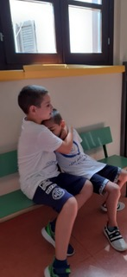
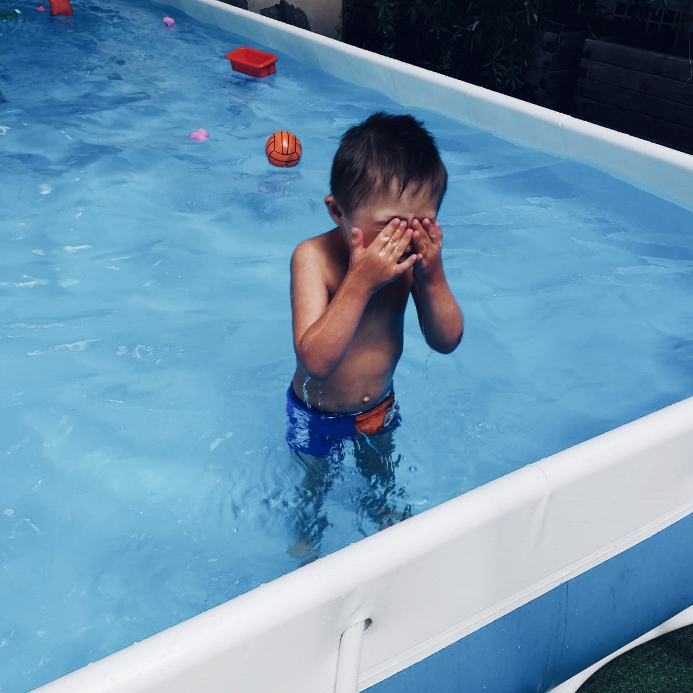
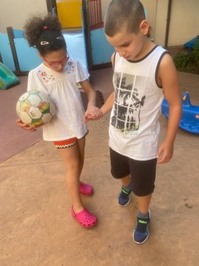
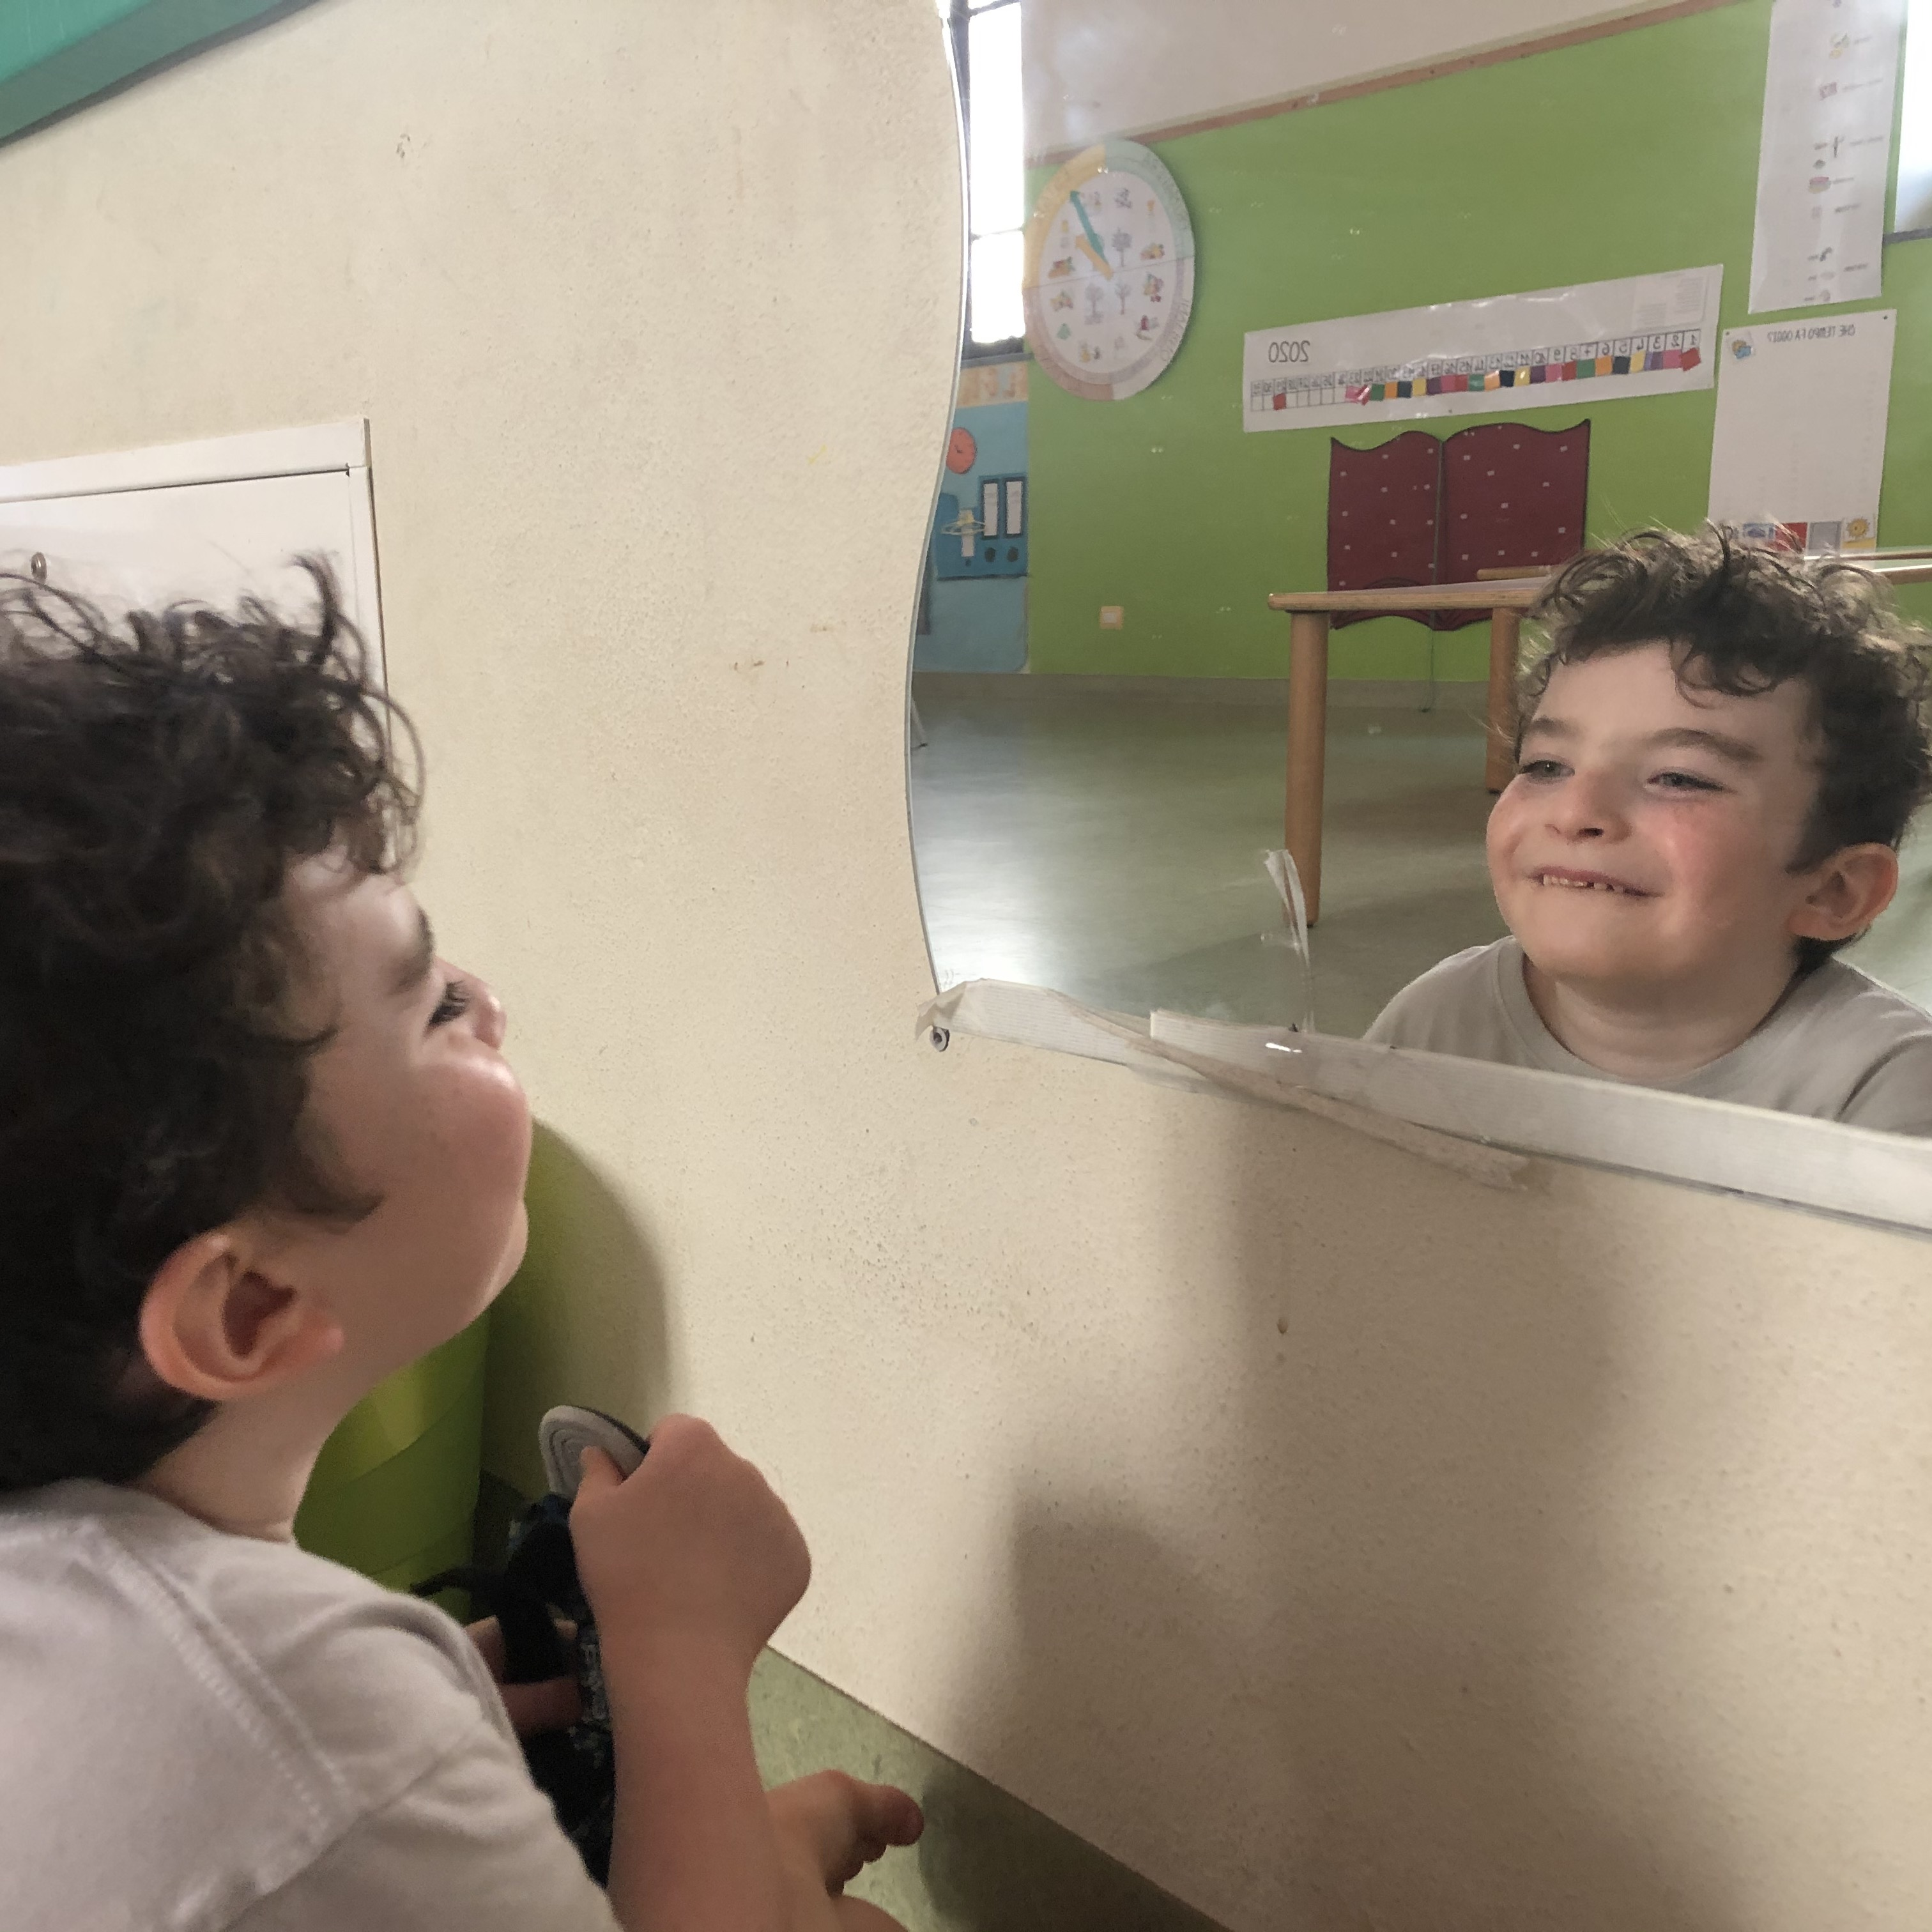
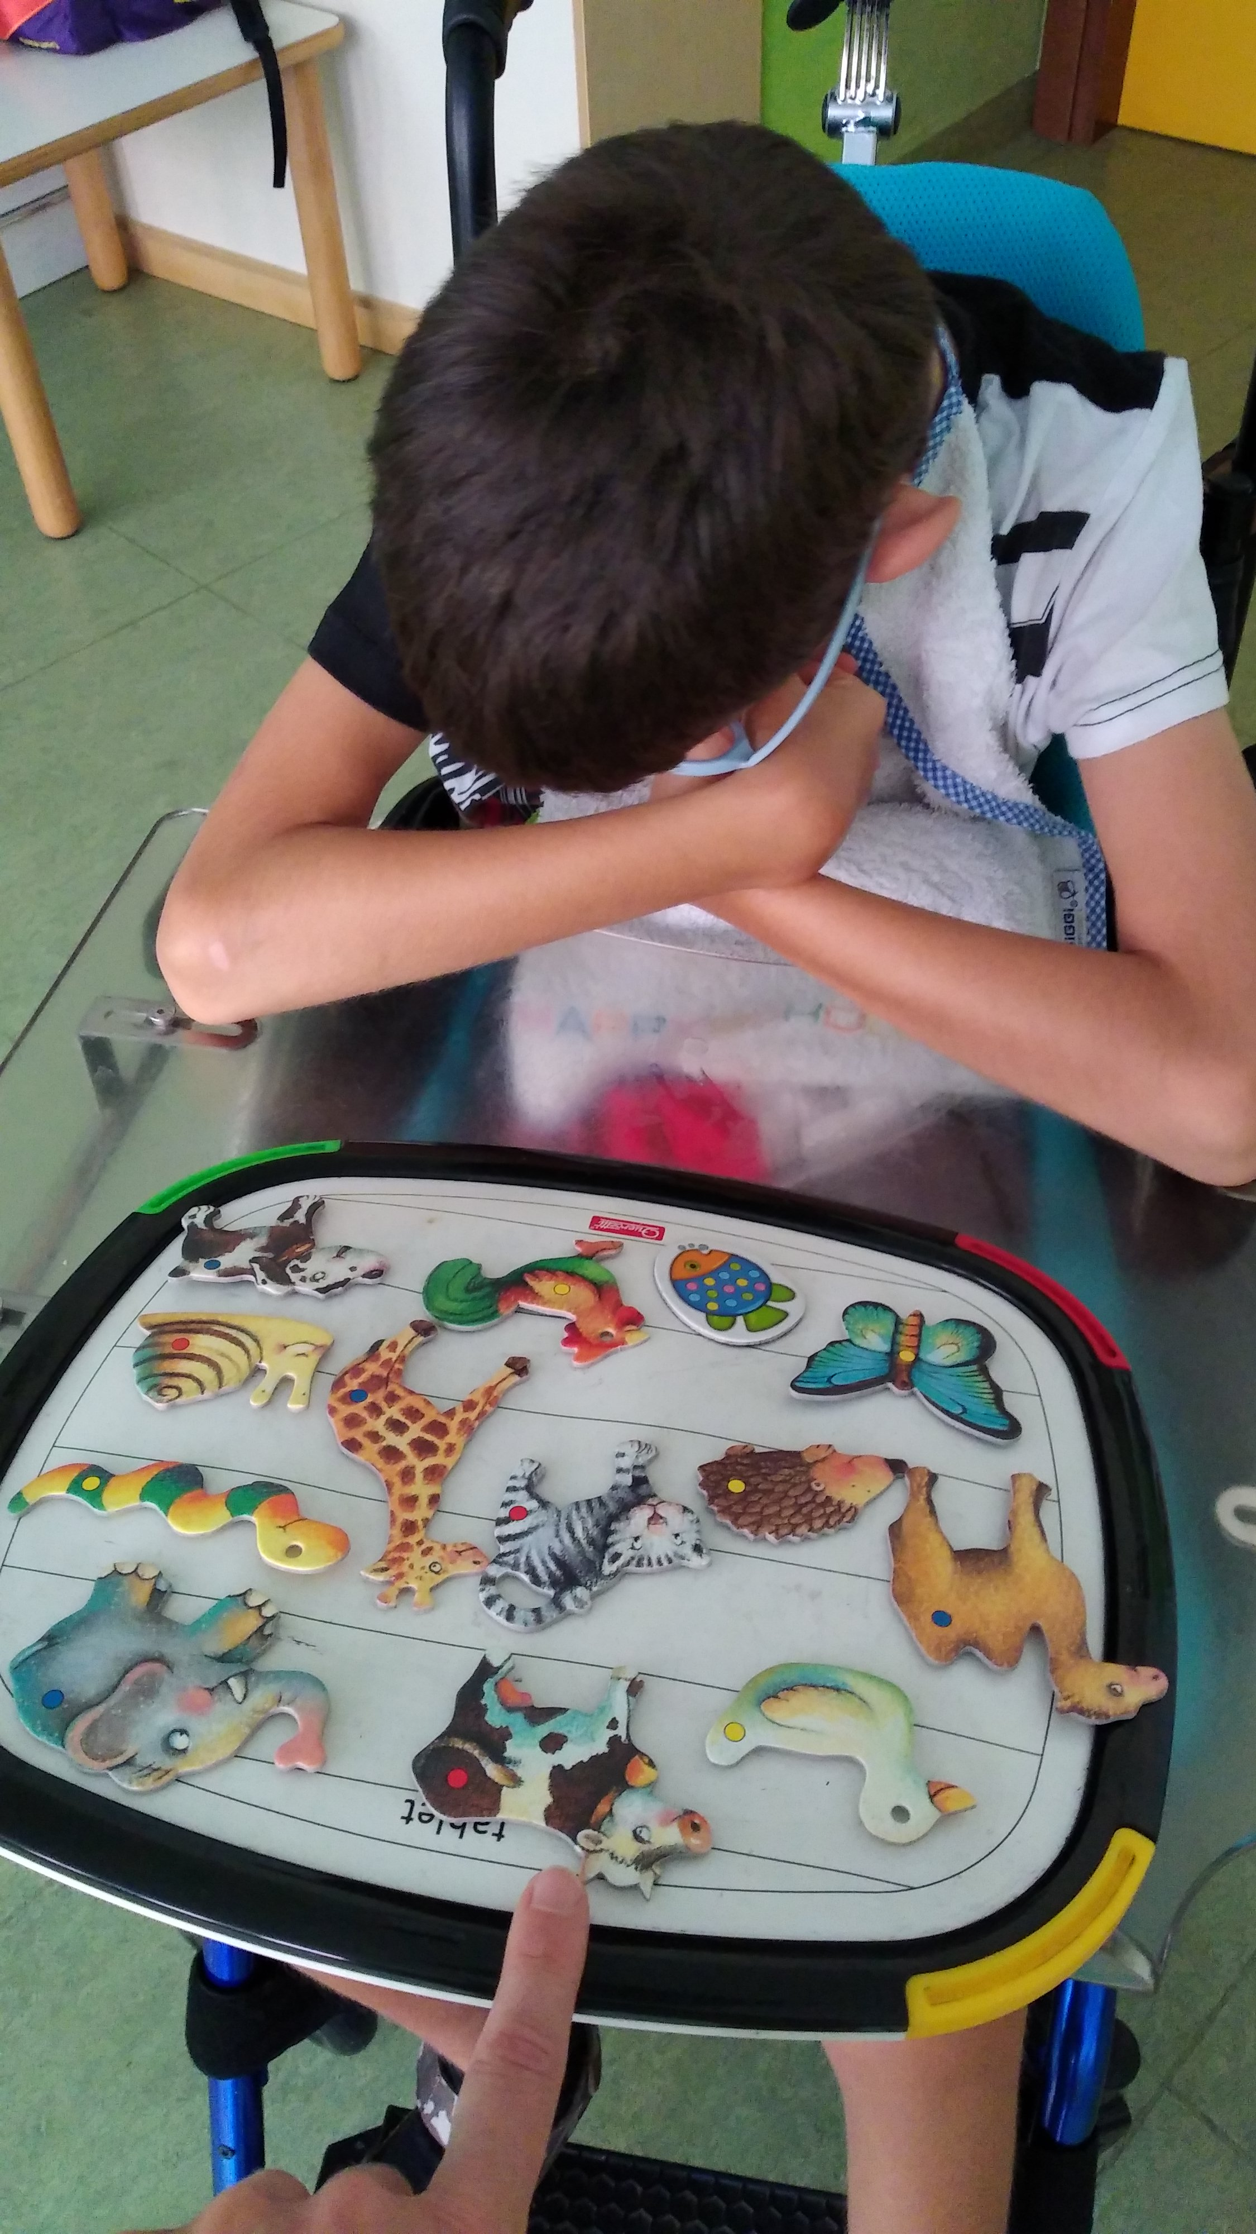
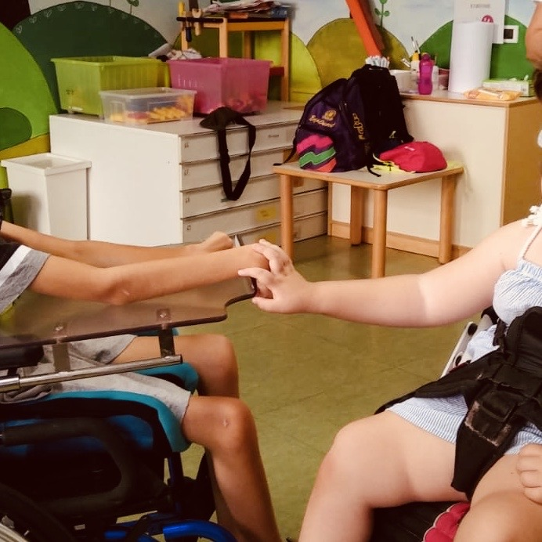
Summer camp:
PICTURES
CR² SINAPSI​ OCCHI AZZURRI ONLUS

Slide 14
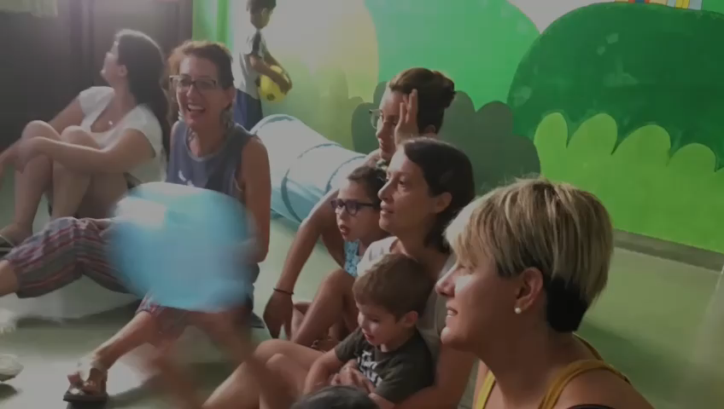
Summer camp:
VIDEO
CR² SINAPSI​ OCCHI AZZURRI ONLUS

Slide 15
Summer camp:
RESULTS
The recipients of the project are children suffering from cognitive disorders, such as autism spectrum syndrome and problems associated with neuro-development disorders. We would like to point out that the activities are recorded and can offer a concrete tool for the management of the problems encountered even outside the summer camp. Any improvements that are detected, are shared with families (to promote new positive educational behavior) and with their doctors so as to update any guidelines or Individual Educational Plans.
The success of the Summer Center has led to calls to extend the services throughout the year and not just during the summer period.
CR² SINAPSI​ OCCHI AZZURRI ONLUS

Slide 16
After the positive experience of our summer camps and considering the community’s needs, the idea to activate CR² recreational and rehabilitative center was established.
The abbreviation “CR” has two meanings: it is the acronym of the Cremona province and it is also the short form of “Centro ricreativo riabilitativo “(R²). The center is a systemic area that is capable of identifying, accepting, responding to families with a disabled child.
CR² would like to become a system that, because of its uniqueness, innovation and attractiveness, can make an important impact through its actions on the community, the social system, health care, economic and for the environment of Cremona.
CR² SINAPSI
PROJECT:
DESCRIPTION
CR² SINAPSI​ OCCHI AZZURRI ONLUS

Slide 17
The purpose of the CR2 project is to create a “recreative and rehabilitative, innovative and experimental center”. Healthcare, educational and social services will be integrated in order to help those children with disabilities and their families.
The design of the center was done through a collaborative process. The first aim is to create a space where the structural elements help the users to feel comfortable, independent of the user’s limitations.
The acronym Sustainable Innovative Neural Architecture Poli Synaesthetic Interaction highlights the importance of this aspect during the design phase.
CR² SINAPSI
PROJECT:
DESCRIPTION
CR² SINAPSI​ OCCHI AZZURRI ONLUS

Slide 18
CR² SINAPSI
PROJECT:
OBJECTIVE 1
To make available for the community a single center, which will be properly equipped for the provision of specialist services. Until now some of those services are not available in our area due to the lack of adequate facilities (such as pools).
To reduce the need to have to travel to other regions to access specific health care services that are not available in Cremona or surrounding areas, and to make those services available in a timely manner.
CR² SINAPSI​ OCCHI AZZURRI ONLUS

Slide 19
To improve the rehabilitative gains for minors with disabilities (both cognitive and physical), psycho-motorial delays and psycho-physical issues as a result of establishing specialized services not currently available.
To reduce the difficulties that families with minors face in identifying adequate responses to their needs, integration between them (in terms of access to services).
To reconciliate the specific needs of the disabled child with those of the whole family unit.
To increase extra-curricular inclusion opportunities for minors with disabilities.
CR² SINAPSI
PROJECT:
OBJECTIVE 2
CR² SINAPSI​ OCCHI AZZURRI ONLUS

Slide 20
To increase the number of health care and social specialists formed to assist minors with cognitive or physical disability, psychomotor delay, psycho-physical issues.
To improve the working capabilities of professionals working with those minors (both health care and social educative figures).
To increase the number of early diagnosis (0-3 years) that allow access to NPIA services within 3 years of age and to upgrade of the response capability of these services (shortening the time between the take charge and the start of the rehabilitation program).
To offer genomic sequencing and other state-of-the-art analysis as an accessible service to everyone.
CR² SINAPSI
PROJECT
OBJECTIVE 3
CR² SINAPSI​ OCCHI AZZURRI ONLUS

Slide 21
A fundamental role will be played by the Scientific Technical Committee, made up of doctors and professionals with different specializations. The Committee will: 1) support the Board of Directors on scientific issues, 2) indicate and identify experimental and / or innovative intervention strategies, 3) promote the construction of the network between medical-rehabilitation centers on the national and European territory, 4) enhance the implementation of training-information activities and scientific dissemination to support the process of local area awareness for "a common good" (well-being of minors).
The Scientific Committee will be charged with keeping the Center at the forefront both in terms of research and in the provision of innovative therapies.
The following professional are currently collaborating on our project:
Prof.ssa Fazzi (Università di Brescia)
Prof.ssa Orcesi (Fondazione Mondino di Pavia)
Prof. Imperadori (Politecnico di Milano)
Dott. Riccardo Sabatini
CR² SINAPSI
PROJECT:
SCIENTIFIC TECHNICAL COMMITTEE
CR² SINAPSI​ OCCHI AZZURRI ONLUS

Slide 22
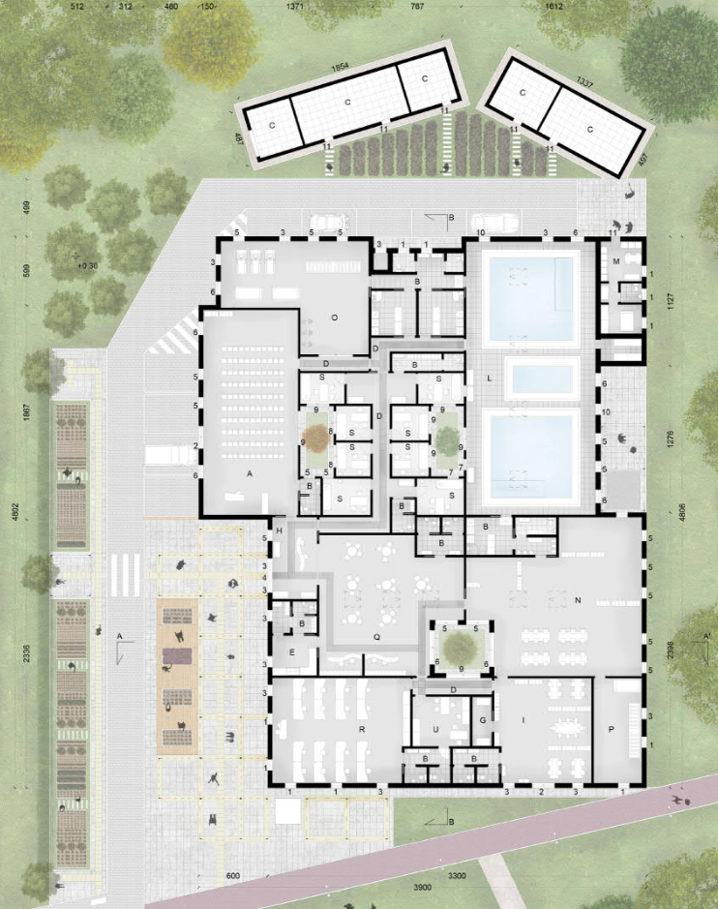
CR² SINAPSI
PROJECT:
PLAN
CR² SINAPSI​ OCCHI AZZURRI ONLUS

Slide 23
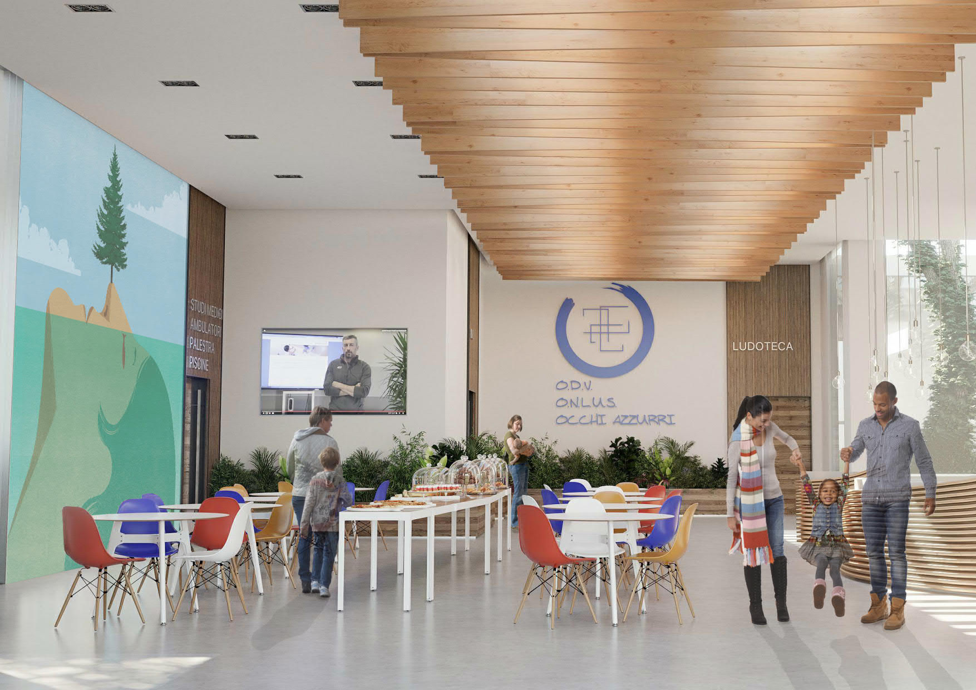
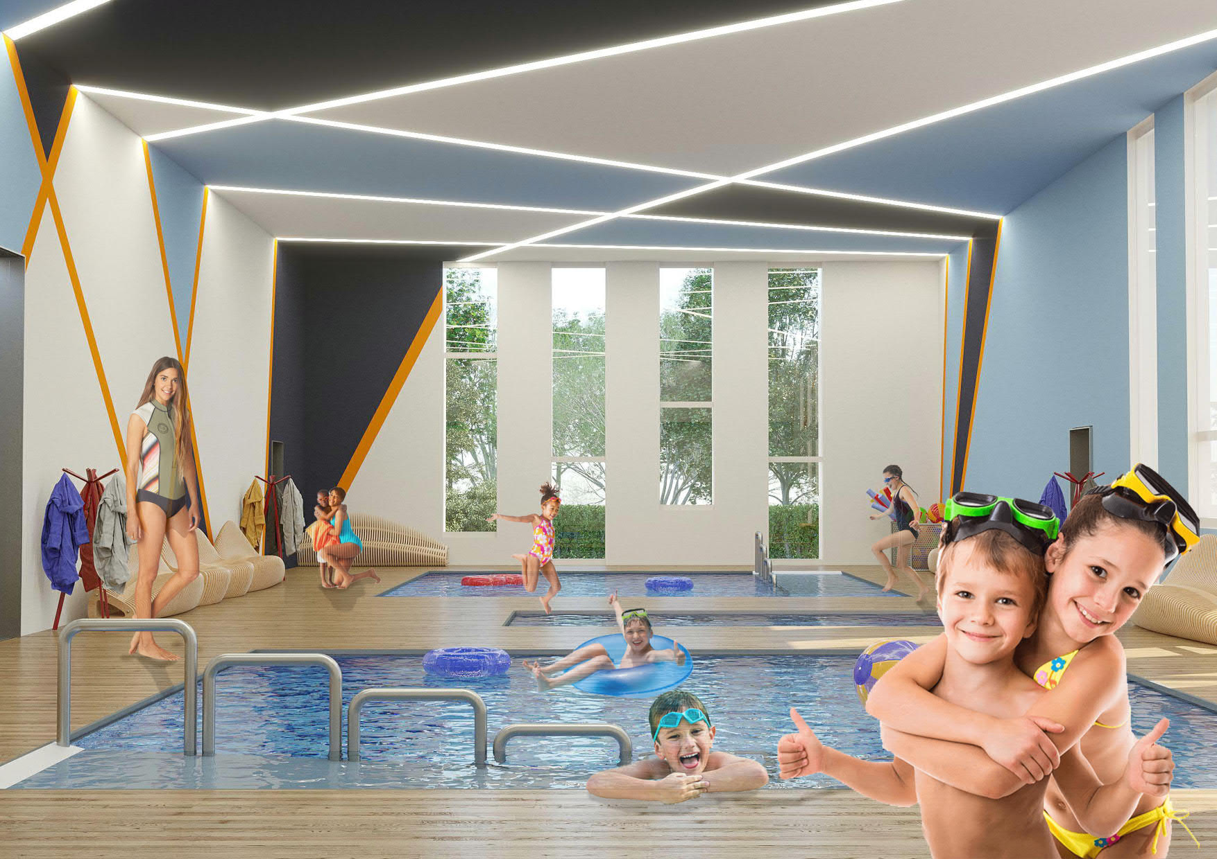
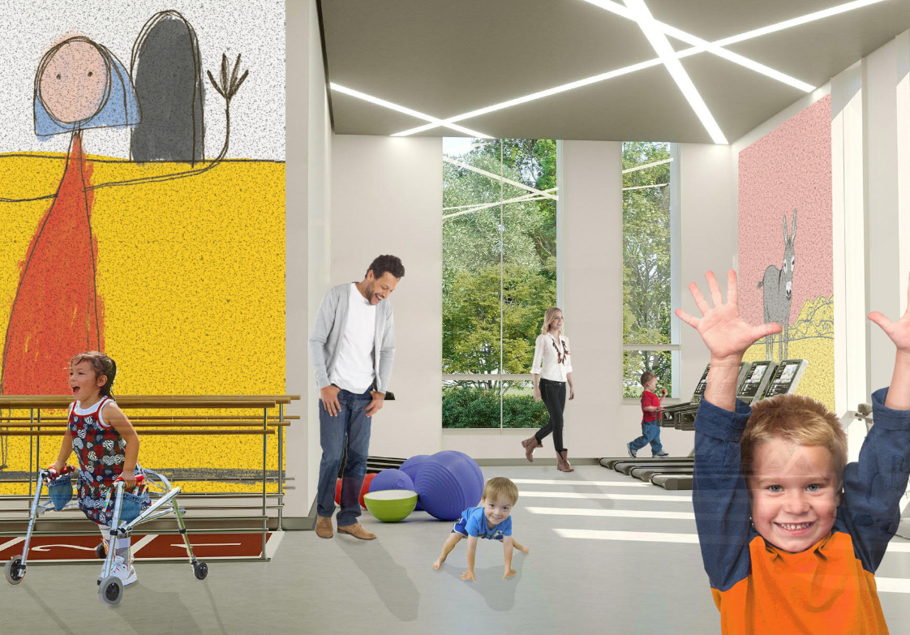
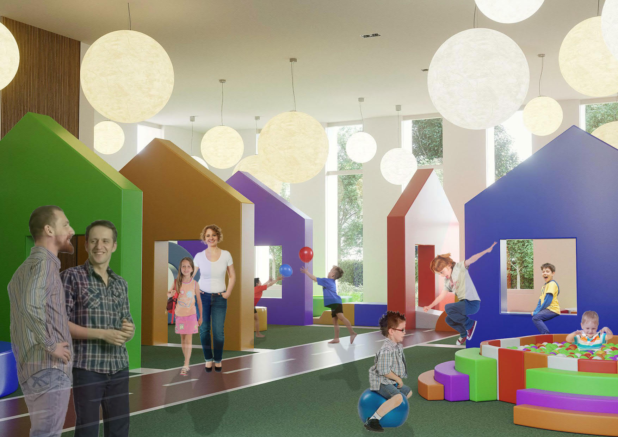
CR² SINAPSI
PROJECT:
VIEWS
CR² SINAPSI​ OCCHI AZZURRI ONLUS

Slide 24
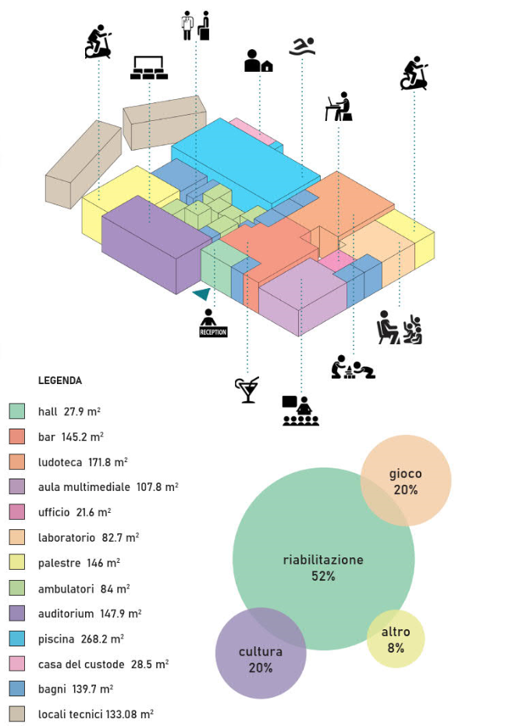
CR² SINAPSI
PROJECT:
STRATEGY
CR² SINAPSI​ OCCHI AZZURRI ONLUS

Slide 25
The idea that underlies the strategy is that families should be considered a system in order to answer the needs of the same. As such it is necessary to observe and read it inside its living context (individuals within the family and community). It becomes important to redefine the way the issues are framed so that the focus is not only on the disabled individual but on the entire family as an integrative system.
The establishment of the family as a system necessitates a location which is able to: provide integrated services, operate in an inclusive way and promote interconnection with social, cultural, ambient life context.
CR2 has been conceived and structured as a systemic place, in which the services offered and the professional skills available are complemented and enriched by offering integrated answers to complex needs, adopting systemic approaches.
CR² SINAPSI
PROJECT:
STRATEGY
CR² SINAPSI​ OCCHI AZZURRI ONLUS

Slide 26
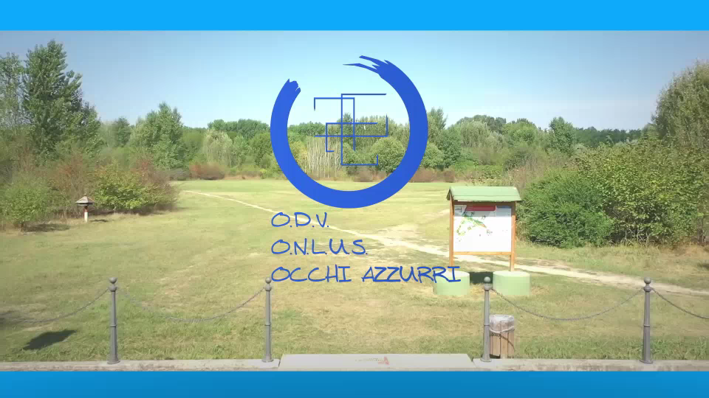
CR² SINAPSI
PROJECT:
VIDEO
CR² SINAPSI​ OCCHI AZZURRI ONLUS

Slide 27
Susteinability and Replicability
The project was established in Cremona, a small city in northern Italy; however, the objectives are not solely focused on the local area.
This genesis was linked to the needs of a specific family but this does not mean that the project is limited to just that.
The initiative is linked to the Cremona area because it aims to meet the needs of people who cannot travel to other areas.
Long journeys to find qualified answers are not practical and are often expensive and therefore not generally sustainable.
The need for family support on these issues is felt at a national level and the project proposal has contents that can be easily exported anywhere.
CR² SINAPSI​ OCCHI AZZURRI ONLUS

Slide 28
Sustainability and Replicability
The center is sustainable on different levels:
• economic and strategic, because it involves the productive fabric of the area where it is located and has an economic plan that generates profits within a few years of operation;
• socio-cultural, because it is carried out through a network of non-profit organizations that contribute to improving the living conditions of the community;
• social – health care, because the family is taken care of with an innovative and systemic scheme for the purpose of total integration and inclusion.
This approach can be used anywhere by adopting a strategy that can become a standard action protocol.
CR² SINAPSI​ OCCHI AZZURRI ONLUS

Slide 29
Sustainability and Replicability
The contribution of universities and medical and scientific excellence can attract investors and economic measures in support of these initiatives also due to the availability of grants and funding for social assistance purposes. These invitations to bid are more easily awarded if the technical committee is recognized at a national or international level.
IMMEDIATE OBJECTIVES
SUPPORT TO THE PATIENT
LONG-TERM OBJECTIVES
LOCAL SUSTAINABILITY
SUPPORT TO RESEARCH
REPLICABLE AT NATIONAL LEVEL
INCREASED SOCIAL-HEALTH CARE SERVICES
FAMILY SUPPORT
CR² SINAPSI​ OCCHI AZZURRI ONLUS

Slide 30
OCCHI AZZURRI ONLUS
Filippo Ruvioli (President): +39 366 5645847
E-MAIL: info@occhiazzurrionlus.org
Office: 0372- 86698
Web: www.occhiazzurrionlus.org
Head Office: Via Cesare Battisti, 10, CR, 26100
Field Office: Via Cappelletti, 3, CR, 26100

